Slide 1
Notes:
Uncle Sam – Recruitment poster

Slide 2
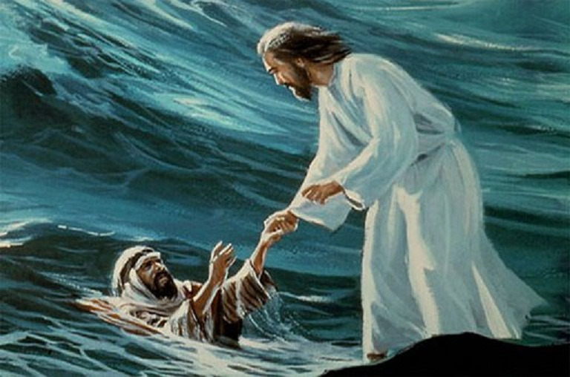
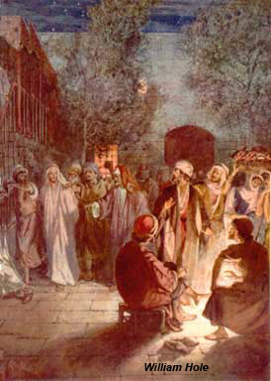
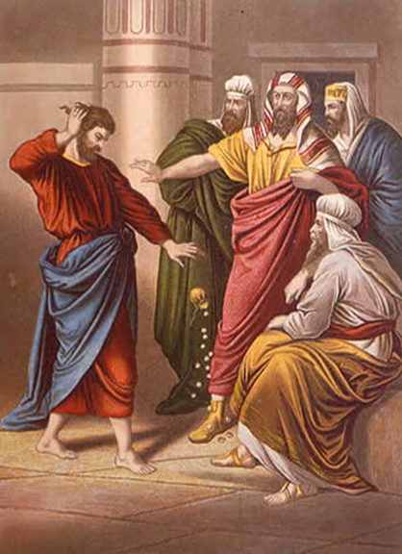
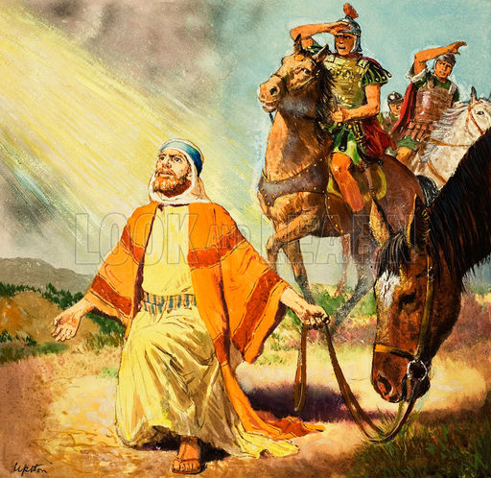
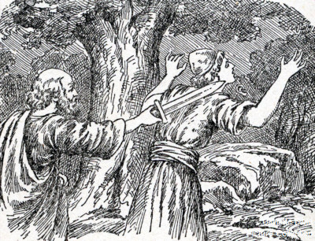
All Applicants Welcome
All candidates must meet the admissions requirements
All candidates must meet the admissions requirements
Notes:
When applying for a job, requirements are the hardest?
Who would you hire of these people?

Slide 3
I Timothy 3:1-7
Qualifications of Overseers
1 This is a faithful saying: If a man desires the position of a bishop, he desires a good work.
(Bishop, overseer, elder, senior leadership)

Slide 4
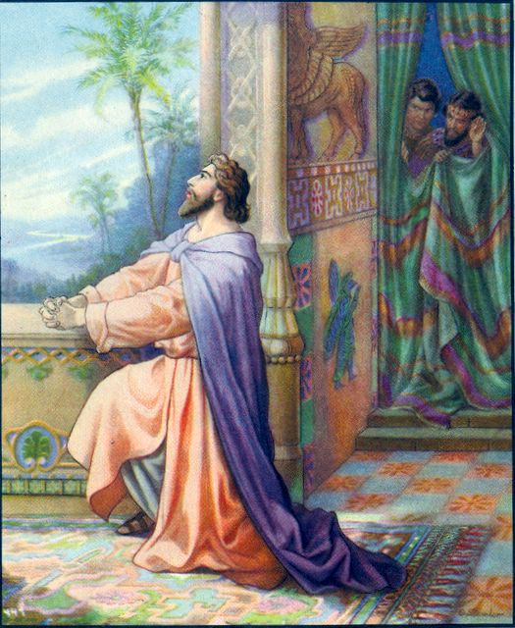
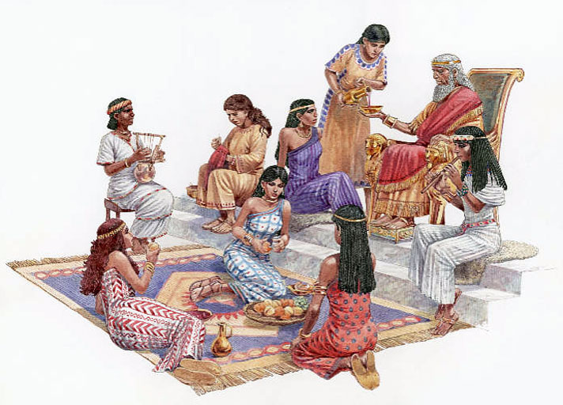
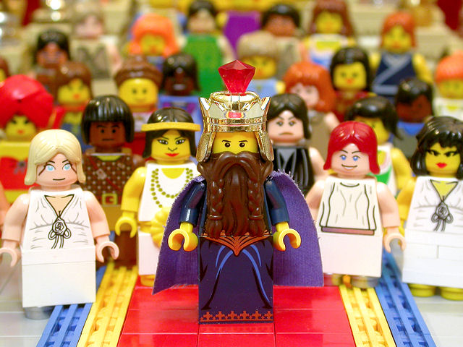
What are the requirements?
2 A bishop then must be blameless,
the husband of one wife,
temperate,
sober-minded,
of good behavior,
hospitable,
able to teach;

Slide 5
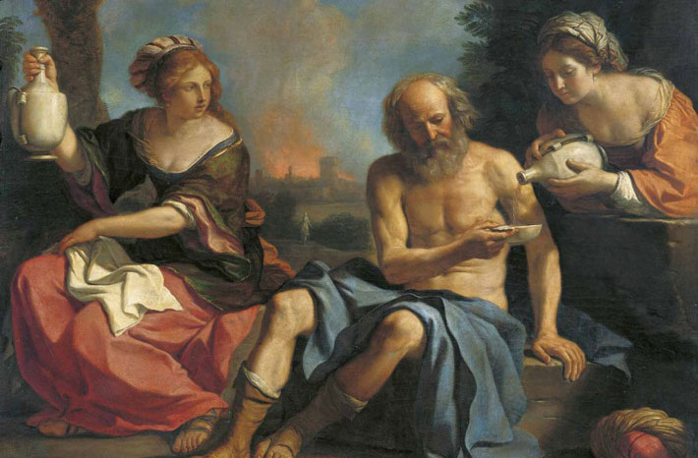
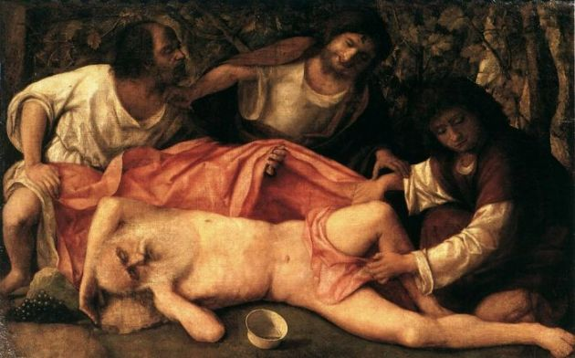
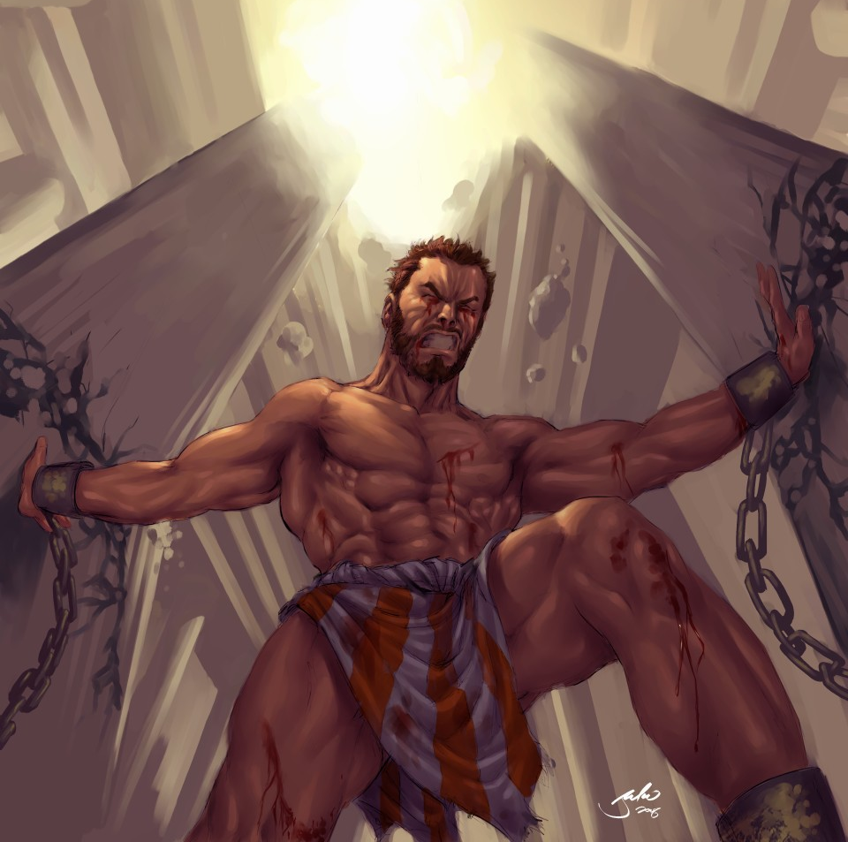
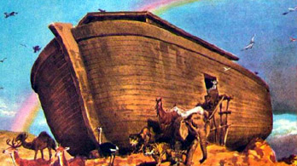
3 not given to wine,
not violent,
not greedy for money,
but gentle,
not quarrelsome,
not covetous;

Slide 6
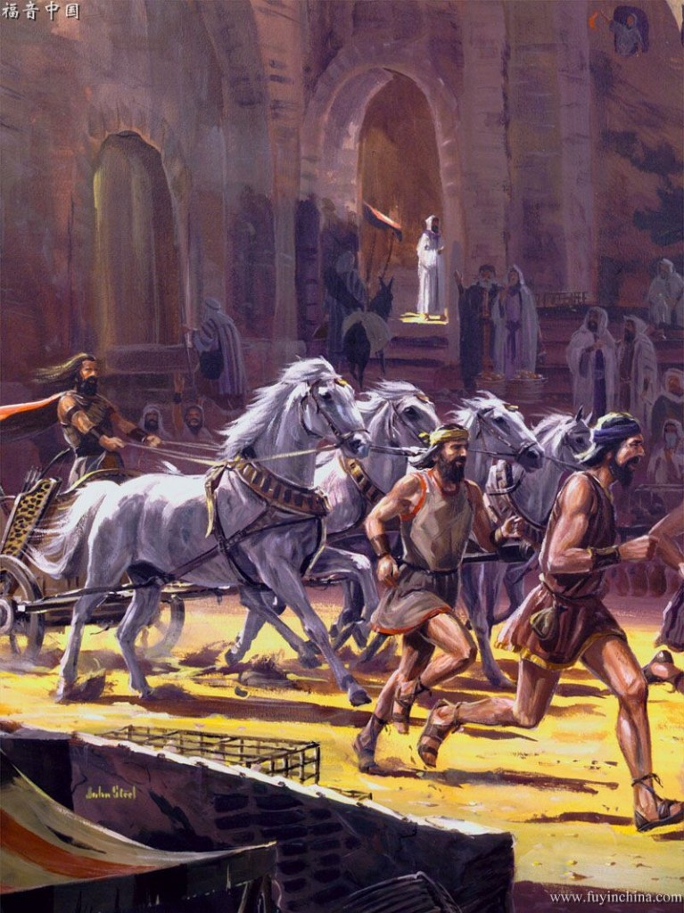
4 one who rules his own house well, having his children in submission with all reverence 5 (for if a man does not know how to rule his own house, how will he take care of the church of God?);
6 not a novice, lest being puffed up with pride he fall into the same condemnation as the devil.
7 Moreover he must have a good testimony among those who are outside, lest he fall into reproach and the snare of the devil.
Notes:
2 Sam 12:14 – opportunity for enemies of God to blaspheme

Slide 7
I. Very few are able to meet all the requirements
How well do you do?
Notes:
God expects us to live out our love for Him
Our lifestyle of faith acting in love is designed to set a pattern for those who are going to believe – awesome responsibility – God forgives sinners!

Slide 8
II. All of us have areas of weakness to work on
Are you making progress?
Notes:
Wage war
Fight - Against Satan & powers of darkness
Against self / old nature
In obedience to the Boss / commander
Revelation 19:10 And I fell at his feet to worship him. But he said to me, “See that you don ot do that! I am your fellow servant, and of your brethren who have the testimony of Jesus. Worship God! For the testimony of Jesus is the spirit of prophecy.”

Slide 9
III. All of us can aim to meet these characteristics
Not all will have a formal position of leadership in the church
All should aspire to leadership – at least in bring others to Christ
Notes:
We make it our goal to be pleasing to him!

Slide 10
The Conclusion
Every Christian must have a good testimony among those who are outside.
What can you do to improve yours?
The devil wants to make YOU a reproach to Christ
What will you do today to steal his joy?

Slide 11
Theme for 2014 GO & MAKE DISCIPLES
LIVE it (the life of a disciple) then
DO it (make disciples!)

